Slide 1
3D Scanning and Spatial Learning Multi-view 4D Volumetric Capture
Marcel Bruckner, Kevin Bein, Moiz Sajid

Slide 2
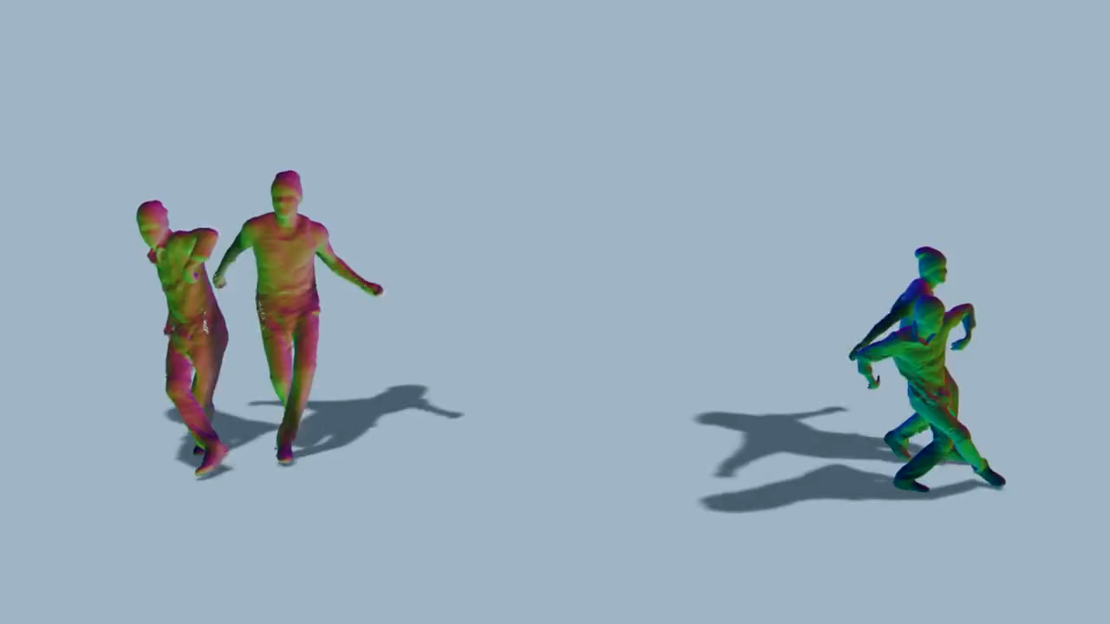
Introduction

Slide 3
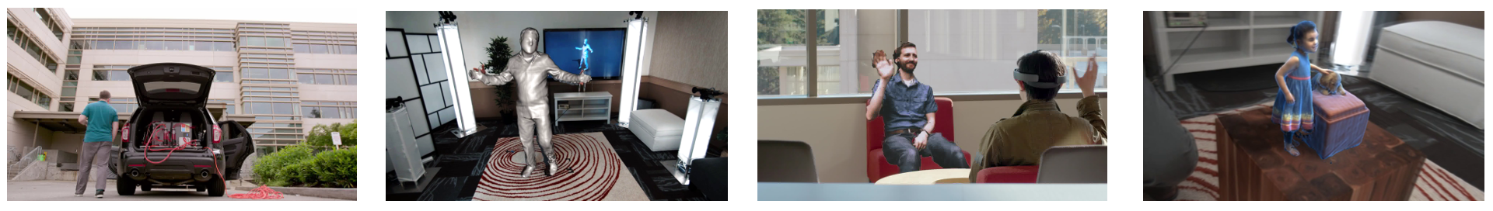
Application
Microsoft Holoportation

Slide 4
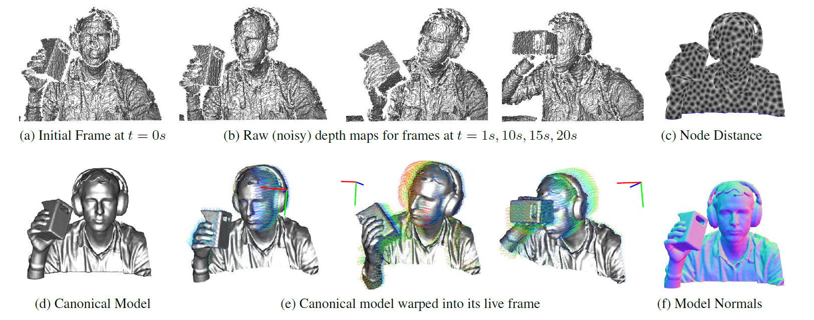
General Overview [Newcombe et al.]

Slide 5
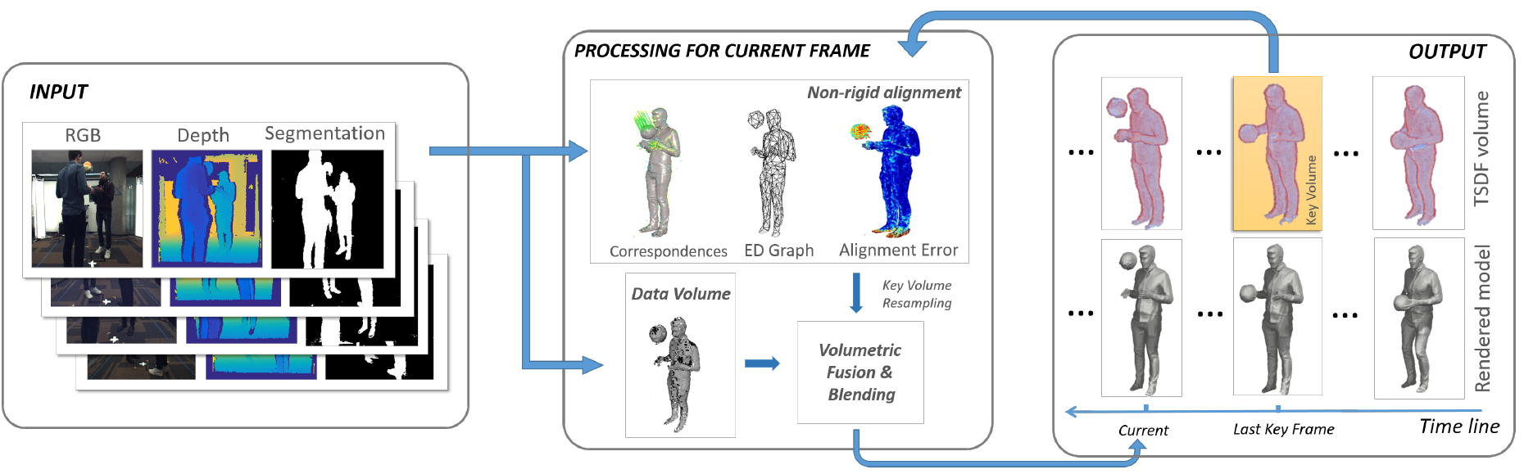
General Overview [Dou et al.]

Slide 6
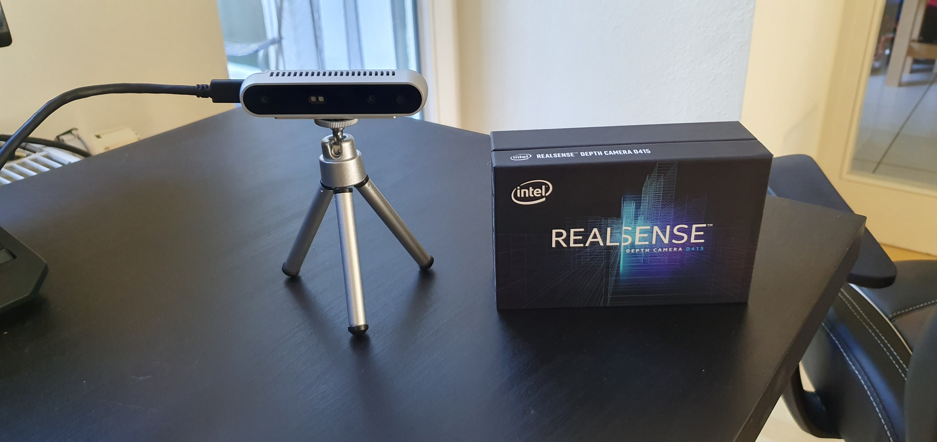
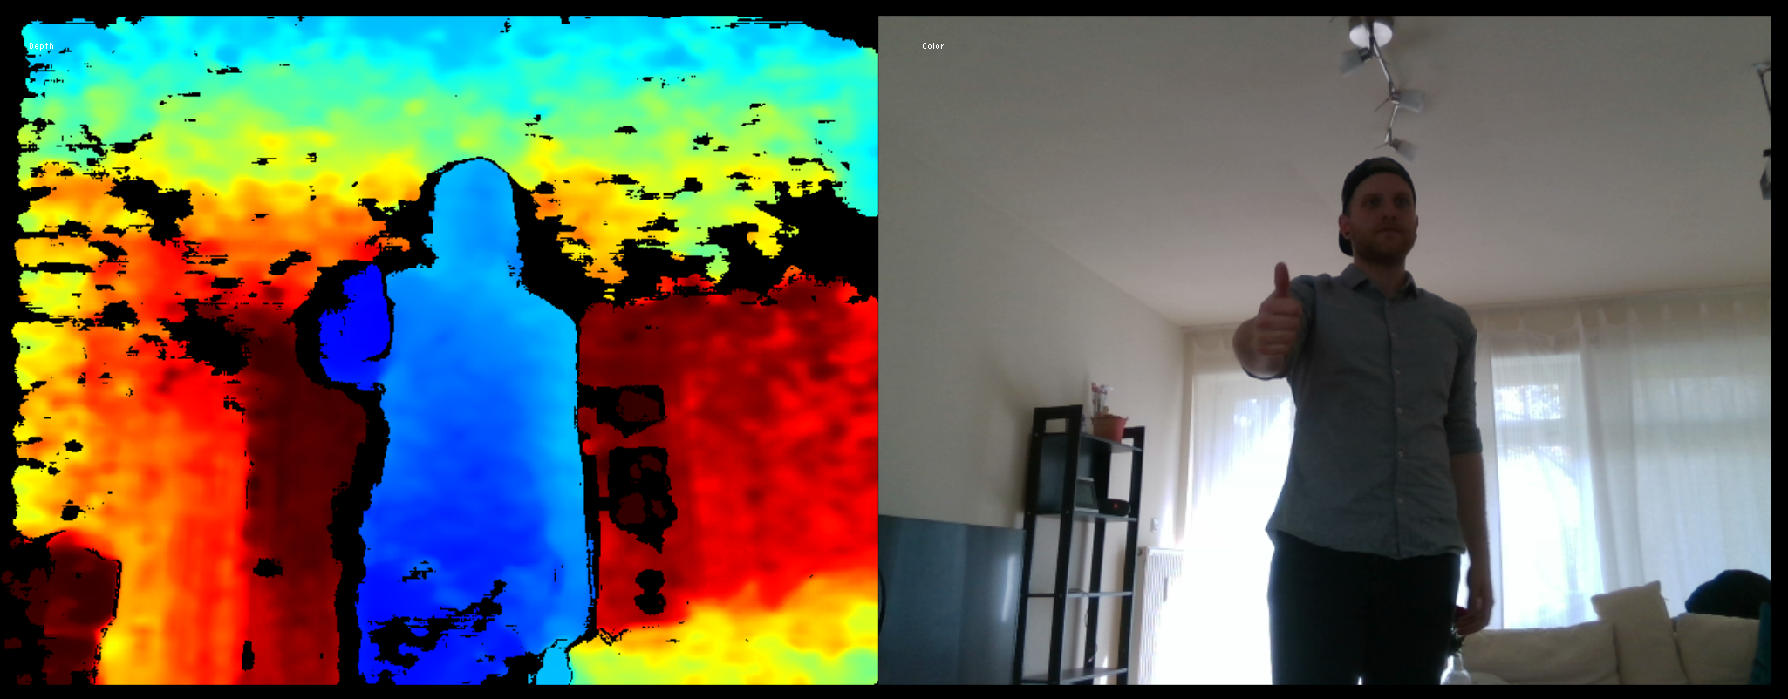
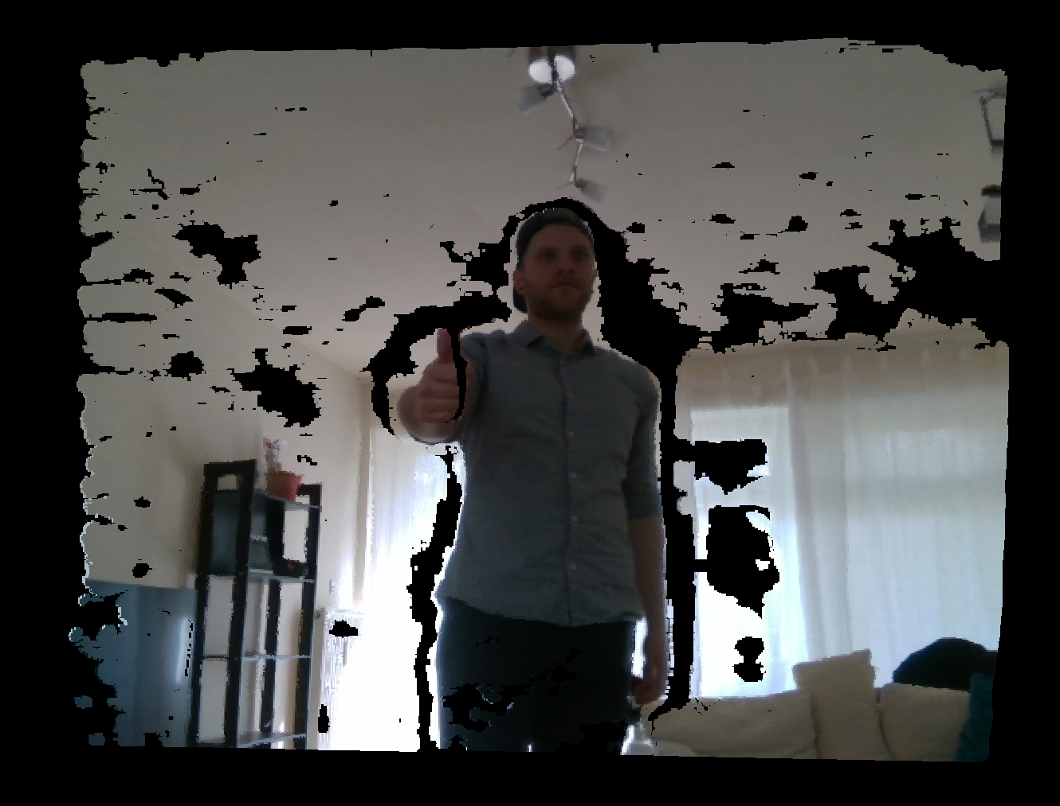
Multi-view 4D Volumetric Capture Setup
Data:
4x Intel Realsense D415
1280x720 active stereo depth
1920x1080 RGB resolution

Slide 7
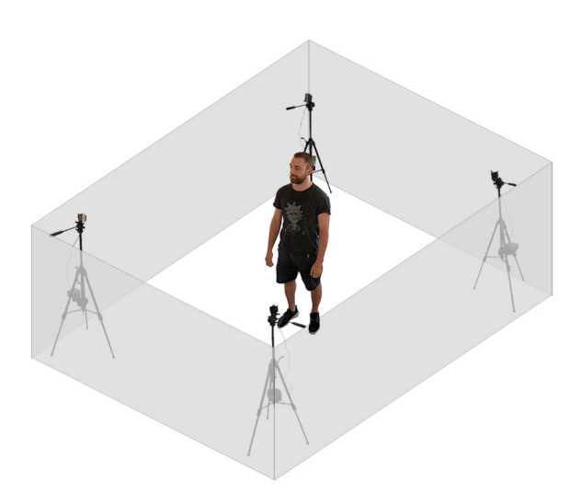
Multi-view 4D Volumetric Capture Setup
4x Intel RealSense™ D415

Slide 8
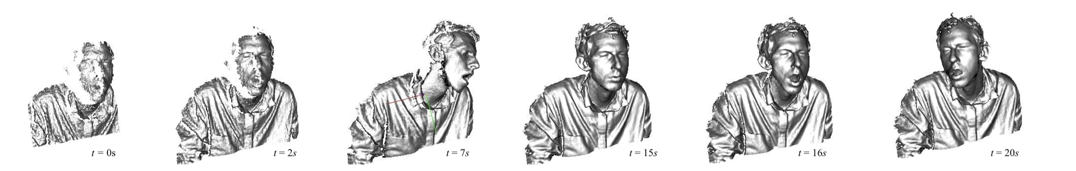
Multi-view 4D Volumetric Capture
DynamicFusion: Reconstruction and Tracking of Non-rigid Scenes in Real-Time [Newcombe et al.]
First dense SLAM system
Capable of reconstructing non-rigidly deforming scenes in real-time
Fusing together RGBD scans captured from commodity sensors.
Estimating a dense volumetric 6D motion ﬁeld
Warps the estimated geometry into a live frame
Not able to handle abrupt topological changes

Slide 9
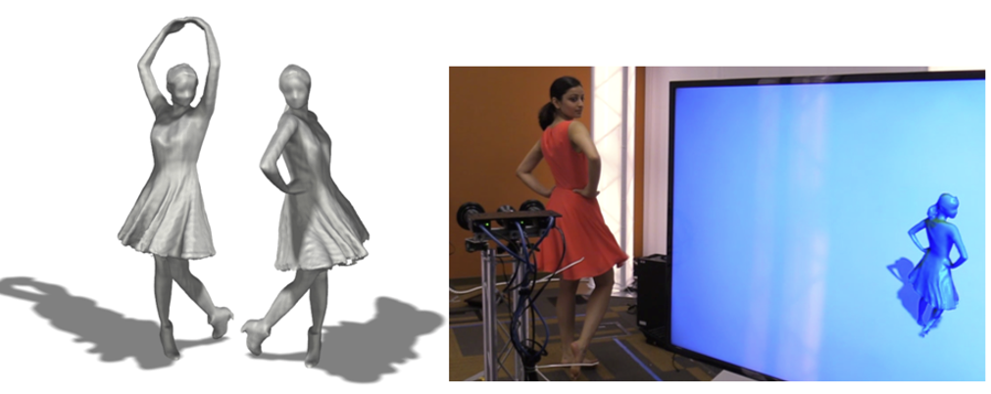
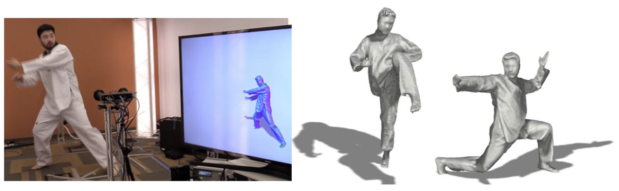
Multi-view 4D Volumetric Capture
Fusion4D: Real-time Performance Capture of Challenging Scenes [Dou et al.]
Pipeline for live multiview performance capture
Generating temporally coherent high-quality reconstructions in real-time.
Supports both incremental reconstruction, improving the surface estimation over time, as well as parameterizing the nonrigid scene motion.
Better able to handle topological changes

Slide 10
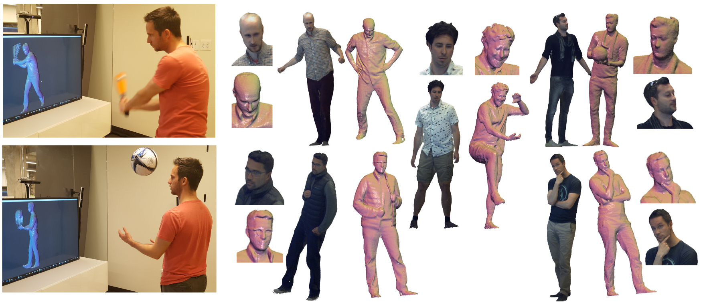
Multi-view 4D Volumetric Capture
Motion2Fusion: Real-time Volumetric Performance Capture [Dou et al.]
New non-rigid fusion pipeline allowing for far more faithful reconstruction of high frequency geometric details
Machine learning technique for 3D correspondence field estimation reducing tracking errors and artifacts that are attributed to fast motions.
a non rigid alignment strategy that more robustly deals with topology changes but is still free from scene priors
3x speedup from previous approaches

Slide 11
Multi-view 4D Volumetric Capture
Done steps
C++ project setup
OpenGL and GLFW
Get in touch with OpenGL and GLFW by doing the OpenGL tutorial to implement a visualization program for the reconstructed scene
Basic window rendering and vertex buffer, vertex array and vertex index setup working
Basic shader program added to render the scene

Slide 12
Multi-view 4D Volumetric Capture
Done steps
Intel RealSense SDK
Get to know the API
Explore examples and setup Volumetric Fusion project for our needs based on the pointcloud example project
Exploring filter techniques for background segmentation

Slide 13
Multi-view 4D Volumetric Capture
Done steps
Basic Setup & Camera setup, Recordings, Visualization code
Multicamera pointcloud rendering
Advanced recording and replaying of depth and color data and pointclouds
Mac support
Basic setup with cmake

Slide 14
Multi-view 4D Volumetric Capture
Planned
OpenGL and GLFW
Gather further knowledge over OpenGL and GLFW by doing the OpenGL tutorial
Improve the visualization program to render dynamically generated scenes
Intel RealSense SDK
Custom image pre/post-processing filters
Camera calibration

Slide 15
Multi-view 4D Volumetric Capture
Planned
Voxel Grid implementation
SDF calculation
Rigid reconstruction
Canonical model
Non-rigid tracking

Slide 16
Project Milestones
Camera setup
10.2019
Preprocessing
10.2019
Volumetric Fusion and Blending
12.2019
Rigid alignment
11.2019
Optimization
12.2019
Non-rigid Tracking
01.2020

Slide 17
Multi-view 4D Volumetric Capture
Image preprocessing
Depth filtering, background subtraction, visual hull computation
Non-rigid shape reconstruction
Sparse voxel grid
Deformation graph construction
Non-rigid tracking
Projective depth ICP
Global sparse correspondences

Slide 18
References
R. A. Newcombe, D. Fox, S. M. Seitz. DynamicFusion: Reconstruction and Tracking of Non-rigid Scenes in Real-Time. IEEE CVPR, 2015
M. Dou, S. Khamis, Y. Degtyarev, P. Davidson, S. R. Fanello, A. Kowdle, S. O. Escolano, C. Rhemann, D. Kim, J. Taylor, P. Kohli, V. Tankovich, S. Izadi. Fusion4D: Real-time Performance Capture of Challenging Scenes. ACM SIGGRAPH, 2016
M. Dou, P. Davidson, S. R. Fanello, S. Khamis, A. Kowdle, C. Rhemann, V. Tankovich, S. Izadi. Motion2Fusion: Real-time Volumetric Performance Capture. ACM SIGGRAPH, 2017

Slide 19
Questions?

